Slide 1
Lab 3: multiplication / dIvision units
CG3207 computer architecture
Week 8, Animesh Gupta

Slide 2
CG3207 Lab 3 (Week 8): Multiplication / Division Units
After Lab 2, you should have been capable to:
Explain the usage of all the control signals
Show the path of a particular instruction on the diagram of ARM processor
Proficiently use the simulation tool to monitor, debug and demonstrate the ARM processor
In Lab 3, you are going to:
Complete and simulate the MCycle to achieve both unsigned and signed division (13 Marks)
Incorporate MCycle to existing ARM processor (Lab2) to achieve multiplication and division (7 Marks)
Enhancement (5 Marks)

Slide 3
CG3207 Lab 3 (Week 8): Multiplication / Division Units
Task 1: MCycle Divider (13 marks)
Only simulation is required
Unsigned + Signed
Test cases: 4-bit only
Divide by 0 is not required
-5/2 = Quotient (-2 or -3) and Remainder (-1 or 1)
Download the Lab3 Template from wiki

Slide 4
CG3207 Lab 3 (Week 8): Multiplication / Division Units
Task 1: MCycle Divider (13 marks)
Download the Lab3 Template from wiki
test_MCycle.v
Complete the logic inside MCycle.v and test_MCycle.v
Verify using multiple testcases.
Synthesize before moving to second part.
(LSW of Product OR
Quotient)
(MSW of Product OR
Remainder)
MCycle.v

Slide 5
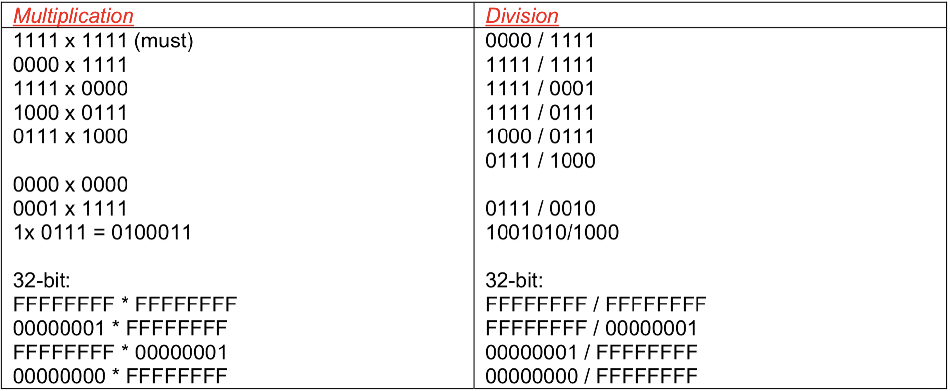
CG3207 Lab 3 (Week 8): Multiplication / Division Units
Suggested Test Cases

Slide 6
CG3207 Lab 3 (Week 8): Multiplication / Division Units
Task 2: Integrate MCycle to Lab2 ARM System (7 marks)
Modify controller, datapath and PC logic
Demo by assembly program (Keil simulation is not functional as desired)
MUL: 32-bit multiplication, LSW 32 bits are kept. So you will get same answer for signed and unsigned cases.
Division (MLA): for unsigned division, signed division is not required
Rd to store quotient, remainder is discarded

Slide 7
CG3207 Lab 3 (Week 8): Multiplication / Division Units
Task 2: Integrate MCycle to Lab2 ARM System (7 marks)
From Lab 2

Slide 8
CG3207 Lab 3 (Week 8): Multiplication / Division Units
Task 2: Integrate MCycle to Lab2 ARM System (7 marks)

Slide 9
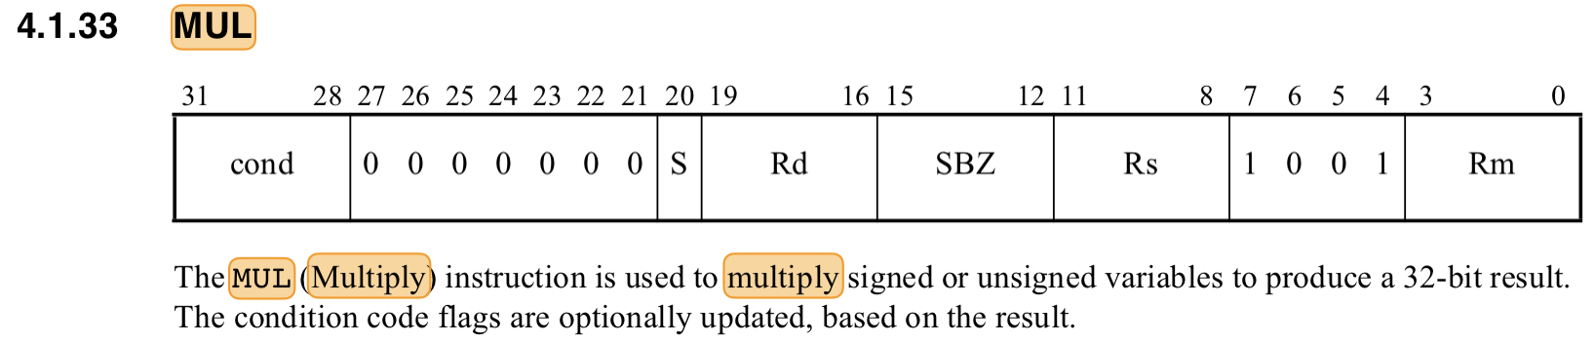
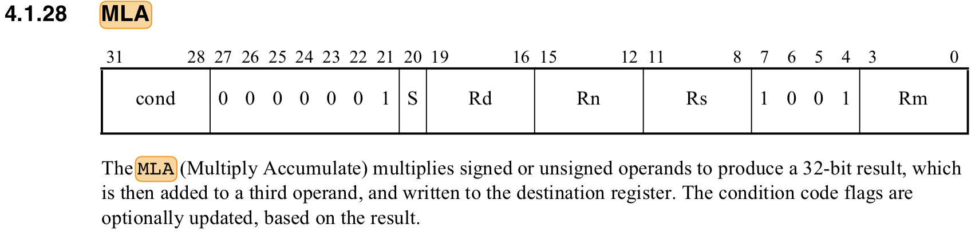
CG3207 Lab 3 (Week 8): Multiplication / Division Units
Assembly Instruction for MULTIPLICATION
Assembly Instruction for DIVISION
No DIV instruction in ARMv3
Interpret MLA as division instruction. Store Quotient in Rd and discard remainder.

Slide 10

CG3207 Lab 3 (Week 8): Multiplication / Division Units
Task 3. Enhancement (5 marks)
Few options: (Only one enhancement is enough)
Reduce no. of cycles required for multiplication (trade-off between hardware complexity and running cycles)
Use single adder for multiplication and division within MCycle, (or share with ALU, too troublesome and MCycle’s ports need to be modified)
Booth multiplication algorithm (self-exploration)

Slide 11
CG3207 Lab 3 (Week 8): Multiplication / Division Units
Lab3: ASM Program
Assembly Program
ARMv3 Processor
Write your own ASM program
including MLA and MUL instructions to proof the functionality of your processor
List out the expected output for each step (useful to compare with HDL simulation and hardware outputs)
Set MCycle as top to simulate signed and unsigned MUL, signed and unsigned DIV (only 4-bit operation is required)
Integrate MCycle into ARM and demonstrate hardware outputs (32-bit operation is required):
MUL (same for unsigned and signed)
Unsigned Division
NOTE: During simulation in Keil, MLA will behave as MLA itself. You will need to stop at that line, and manually modify the result of MLA, and then continue with the rest of the simulation to have parity with the behaviour of the hardware they implement (which does division).

Slide 12
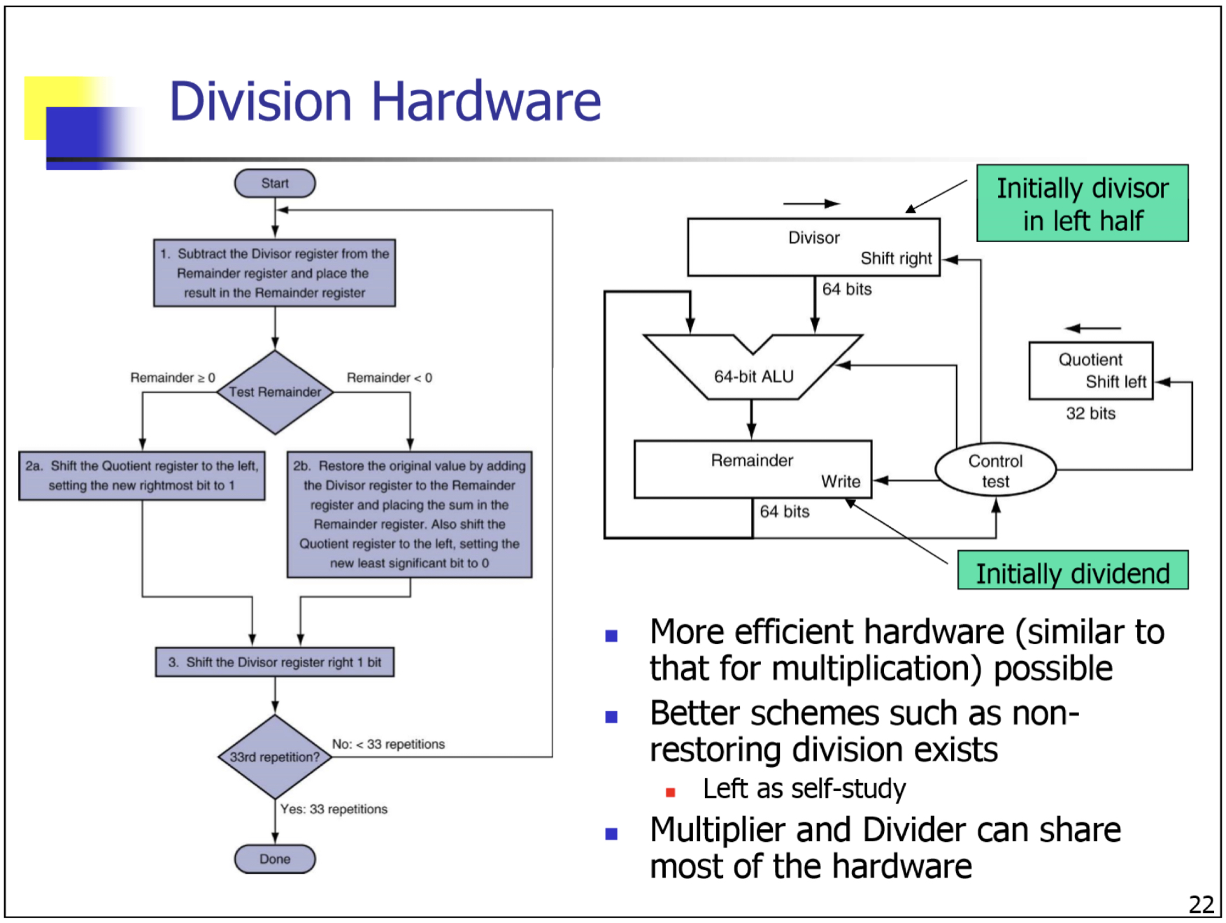
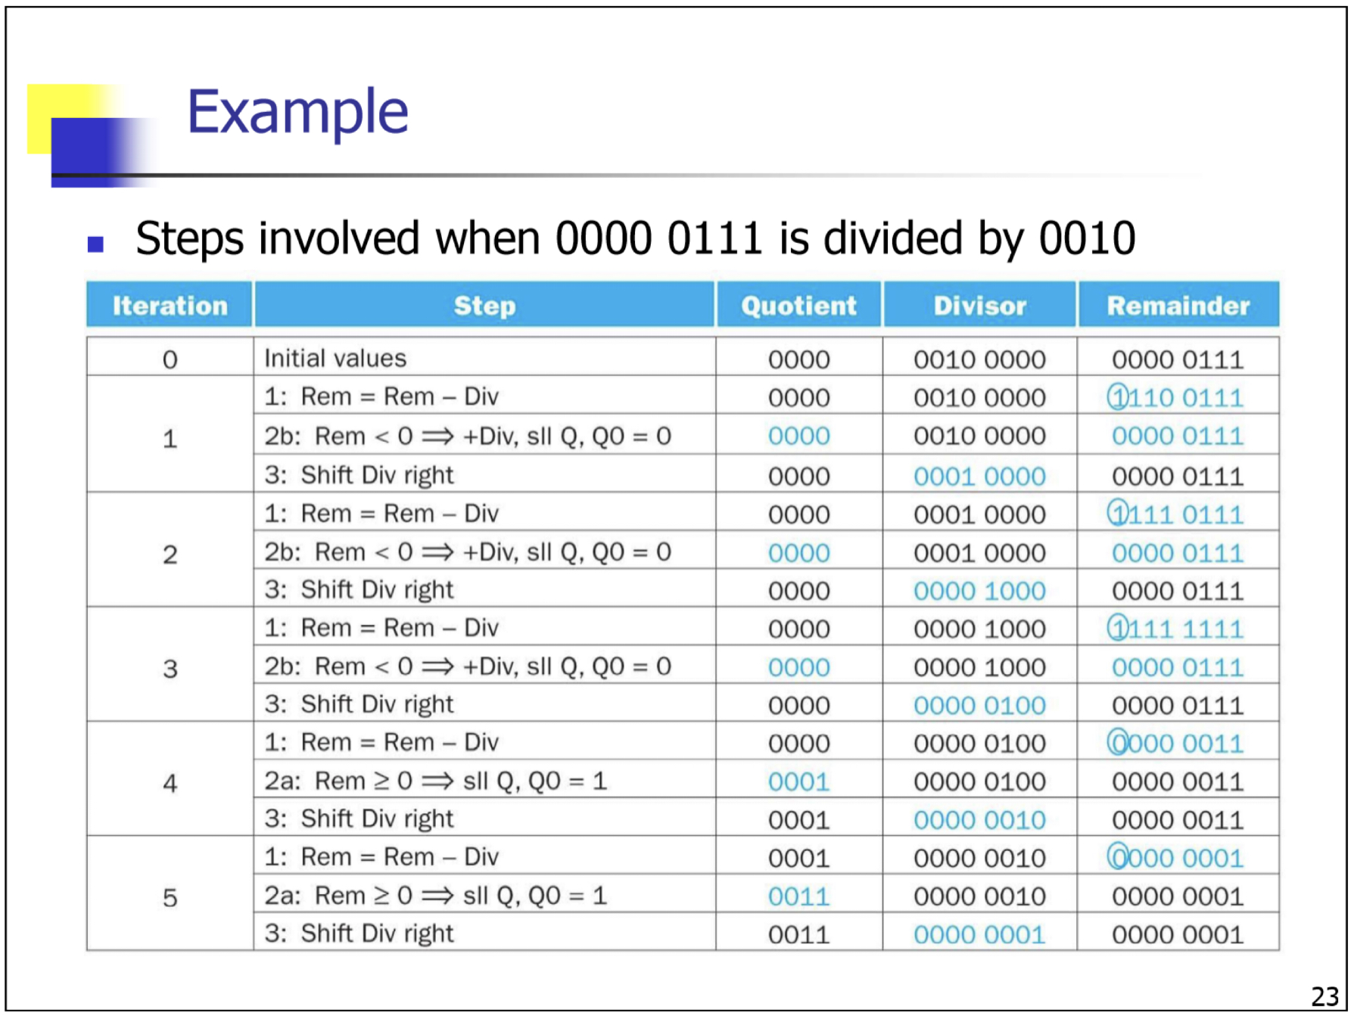
CG3207 Lab 3 (Week 8): Multiplication / Division Units
Lab3: Expected Outcome
Fully understand the given MCycle, i.e. number of cycles for specific operation, how the processor is stalled during Multiplication or Division operation etc....
Fully understand the multiplication algorithm in the given MCycle, and the enhanced algorithm you used (if any). You should be able to explain the algorithm by hand-writing the process.
Know the modifications you have done on ARM from Lab2 onward, and the reasons.
Think about the advantages and trad-offs of algorithm approaches you chose to use/not use.

Slide 13
CG3207 Lab 3 (Week 8): Multiplication / Division Units
The end

Slide 14
CG3207 Lab 3 (Week 8): Multiplication / Division Units
Lab3: ASM Program (Option 1)
Assembly Program
ARMv3 Processor
Modify the given HelloWorld.s by adding MUL and MLA instructions to
Print “Welcome to CG3207” in response to “A\r” if all the instructions in the program are supported correctly by your processor
RealTerm is needed
Set MCycle as top to simulate signed and unsigned MUL, signed and unsigned DIV (only 4-bit operation is required)
Integrate MCycle into ARM and demonstrate hardware outputs (32-bit operation is required):
MUL (same for unsigned and signed)
Unsigned Division

